Slide 1

Object oriented programming
Lecture 9
Notes:
Are your classroom colors different than what you see in this template? That’s OK! Click on Design -> Variants (the down arrow) -> Pick the color scheme that works for you!
Feel free to change any “You will…” and “I will…” statements to ensure they align with your classroom procedures and rules!

Slide 2
Java OOP (II)
Java Inheritance
Java Method Overriding
Java super Keyword
Abstract Class & Method
Java Polymorphism
Java Encapsulation

Slide 3
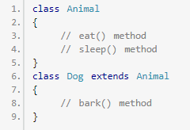
Java Inheritance
Inheritance is one of the key features of OOP (Object-oriented Programming) that allows us to define a new class from an existing class
we use the extends keyword to inherit from a class. Here, we have inherited the Dog class from the Animal class.
The Animal is the superclass (parent class or base class), and the Dog is a subclass (child class or derived class).

Slide 4
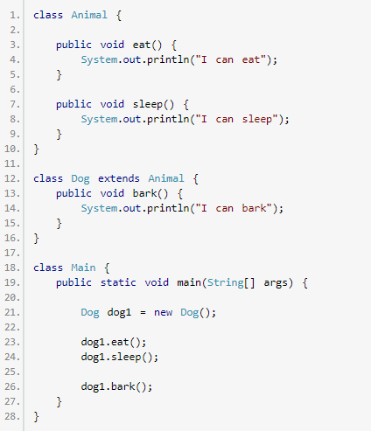
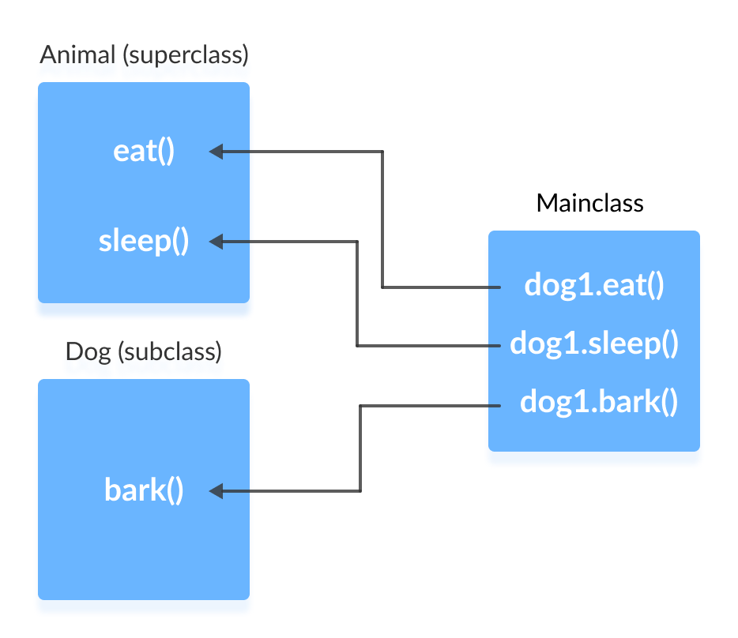
Java Inheritance

Slide 5
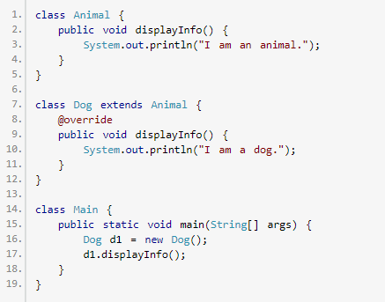
Method overriding

Slide 6
Method overriding
If the same method is defined in both the superclass class and the subclass class, then the method of the subclass class overrides the method of the superclass. This is known as method overriding.
Both the superclass and the subclass must have the same method name, the same return type and the same parameter list.
We cannot override the method declared as final and static.
We should always override abstract methods of the superclass.

Slide 7
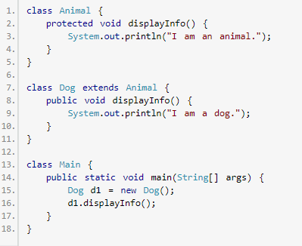
Access Specifier in Overriding

Slide 8
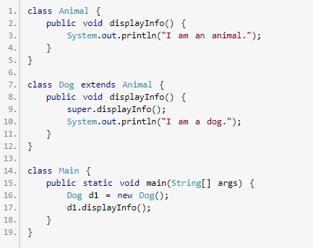
Super Keyword

Slide 9
Super Keyword
The super keyword in Java is used in subclasses to access superclass members (attributes, constructors and methods).
To call methods of the superclass that is overridden in the subclass.
To access attributes (fields) of the superclass if both superclass and subclass have attributes with the same name.
To explicitly call superclass no-arg (default) or parameterized constructor from the subclass constructor.

Slide 10
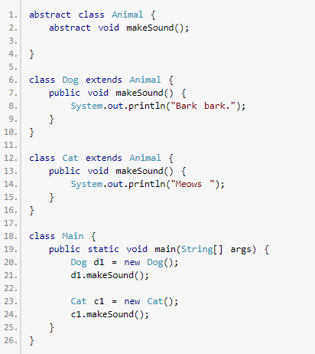
Java Abstract Class and Abstract Methods

Slide 11
Java Abstract Class and Abstract Methods
Abstraction is an important concept of object-oriented programming. Abstraction only shows the needed information and all the unnecessary details are kept hidden. This allows us to manage complexity by omitting or hiding details with a simpler, higher-level idea.
We use the abstract keyword to create abstract classes and methods.
An abstract method doesn't have any implementation (method body).
A class containing abstract methods should also be abstract.
We cannot create objects of an abstract class.
To implement features of an abstract class, we inherit subclasses from it and create objects of the subclass.
A subclass must override all abstract methods of an abstract class. However, if the subclass is declared abstract, it's not mandatory to override abstract methods.
We can access the static attributes and methods of an abstract class using the reference of the abstract class.

Slide 12
Java Polymorphism
Polymorphism is an important concept of object-oriented programming. It simply means more than one form. That is, the same entity (method or operator or object) behaves differently in different scenarios.
In Java, Polymorphism can be divided into two types:
Run-time Polymorphism
Compile-time Polymorphism

Slide 13
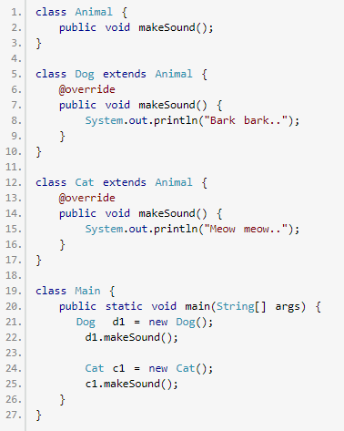
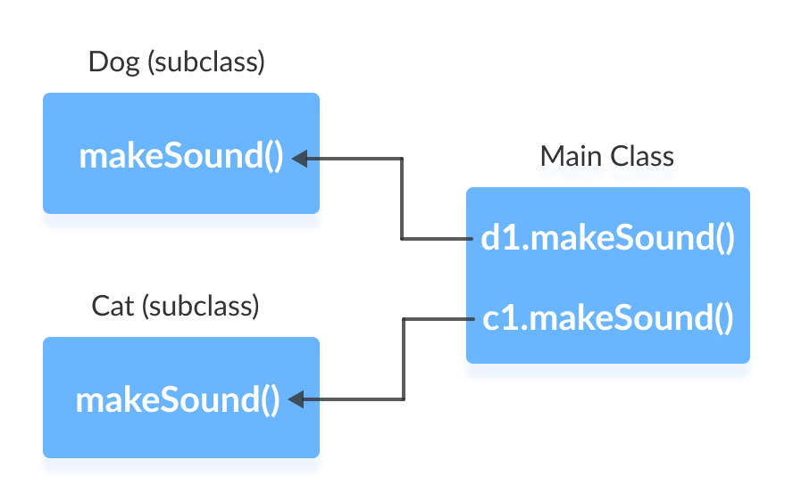
Java Polymorphism

Slide 14
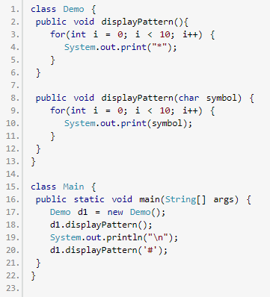
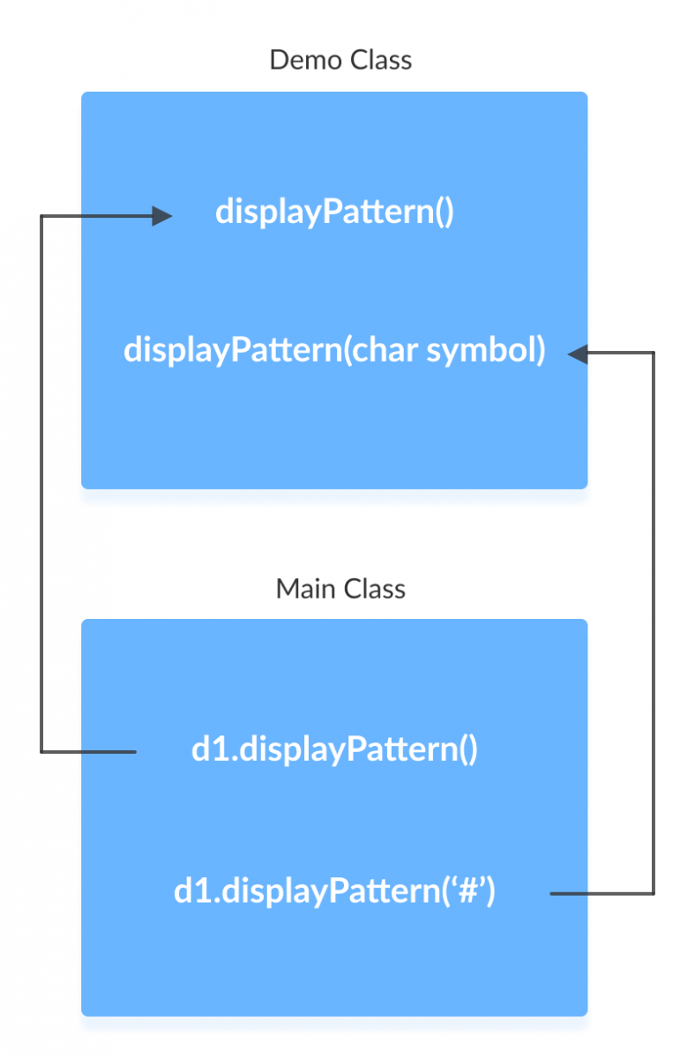
Java Polymorphism

Slide 15
Java Encapsulation
Encapsulation refers to the bundling of fields and methods inside a single class.
Bundling similar fields and methods inside a class together also helps in data hiding.
In Java, encapsulation helps us to keep related fields and methods together, which makes our code cleaner and easy to read.
It helps to control the modification of our data fields

Slide 16
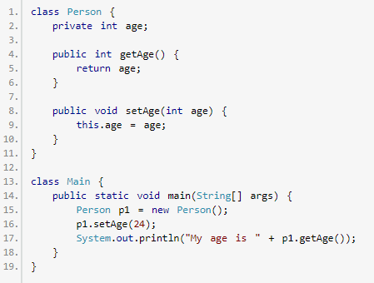
Java Encapsulation

Slide 17
Java Encapsulation

Slide 18
Java Encapsulation
Calculate Area of Square and Rectangle using Class and Polymorphism?
Calculate power of a number using Class and Encapsulation?

